Slide 1



The F# Path to Data Scripting Nirvana
Tomas Petricek, .NET MVP (F#), fsharpWorks
Isaac Abraham, .NET MVP, (C#), elastacloud

Slide 2
TL;DL – What You Will Learn Today
…learn about F# as a technology and ecosystem
…learn the magic of Azure scale F# data scripting with MBrace
…learn about F# projects and F# scripting in Visual Studio
…learn the magic of FSharp.Data

Slide 3
libraries and tools mac & linux teaching F# user groups snippets consulting and training tutorials
F# Software Foundation
open-source community Xamarin Studio
http://www.fsharp.org
contributions research non-profit cross-platform testimonials

Slide 4
What is the problem? Programmers delivering correct, efficient components in the enterprise, on-time
Functional-first programming helps to solve this.

Slide 5
Case Study: Energy sector
I have written an application to balance the national power generation schedule for an energy company.
The calculation engine was written in F#.
The use of F# to address the complexity at the heart of this application clearly demonstrates a sweet spot for the language (…) analysis of large data sets.
Simon Cousins

Slide 6
Case Study: Energy sector
Zero
bugs in deployed system
“F# is the safe choice for this project,
any other choice is too risky”
An application to evaluate the revenue due from Balancing Services contracts in the UK energy industry
http://simontcousins.azurewebsites.net/does-the-language-you-use-make-a-difference-revisited/

Slide 7
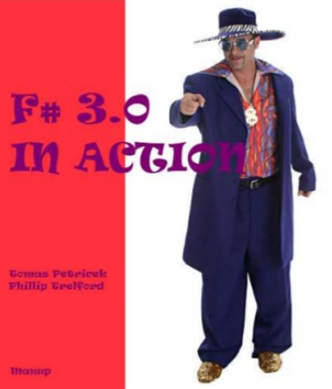
Use F# for Fun and Profit!
Time to Market
Efficiency
Correctness
Complexity
In F#, fun is a keyword!

Slide 8

DEMO Calling REST services with type providers

Slide 9
REST API Demo recap
Just another Visual Studio template!
Install Visual F# PowerTools for advanced tooling
Use REPL for exploration and experimentation
F# Data for JSON, XML, CSV and HTML
JSON.NET, WebClient and other standard libraries work too!
Not like XML literals. Type providers for everything!
This is easy, you can try it now!

Slide 10

DEMO Understanding the World with F#

Slide 11
The World Demo recap
Interactive visualization & charting
Foogle charts, F# Charting and others
Great experience in REPL but also inside apps
FsLab package of libraries
Data analytics package for .NET with F# and C# support New web site coming soon! Check out www.fslab.org
Open-source. You can contribute now!

Slide 12










Libraries and type providers

Slide 13

DEMO Running F# in the Cloud

Slide 14
The Cloud demo recap
cloud { … }

Slide 15
Questions?

Slide 16
Fsharp.org
YWL about F# culturally: as a technology and community and consultants
YWL create a project with F# in Visual Studio
F# interoperates seamlessly with C#
YWL that the Visual F# Power Tools exist
How to find them
YWL that F# has consultants, profit, training, commercial ecosystem, you can hire
YWL to use the F# REPL in Visual Studio
YWL how to reference FSharp.Data and make web request for JSON data
You can also use JSON.NET, WebClient, … from F#
YWL about the type providers in FSharp.Data
You look at the JSON type provider in particular, and how to use it to consume a service that provides JSON data
This is not XML literals in VB
Along the way… YWSee some of the interactive charting options available in F#
They are similar, we will be using Foogle (produces HTML), there’s also FSharp.Charting and others. They are all open source, you can contribute to them
YWL two key technologies for F# + Azure: FSharp.Azure and MBrace
YWL that FSharp.Azure is a set of type providers for F# + Azure Storage (Tables, Blobs, Queues)
YWL that MBrace = cloud { … } = F# code directly via the REPL on ’00s of cores on Azure
cloud { … } OMG , Autoscale, Mbrace, Brisk, Open source
YWL that it is simple to create a new Mbrace cluster on Azure

